Slide 1
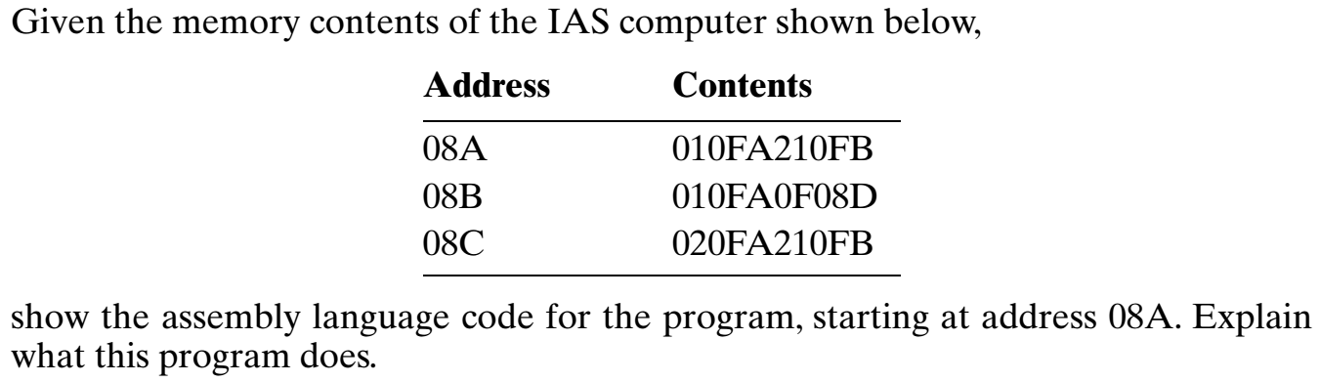
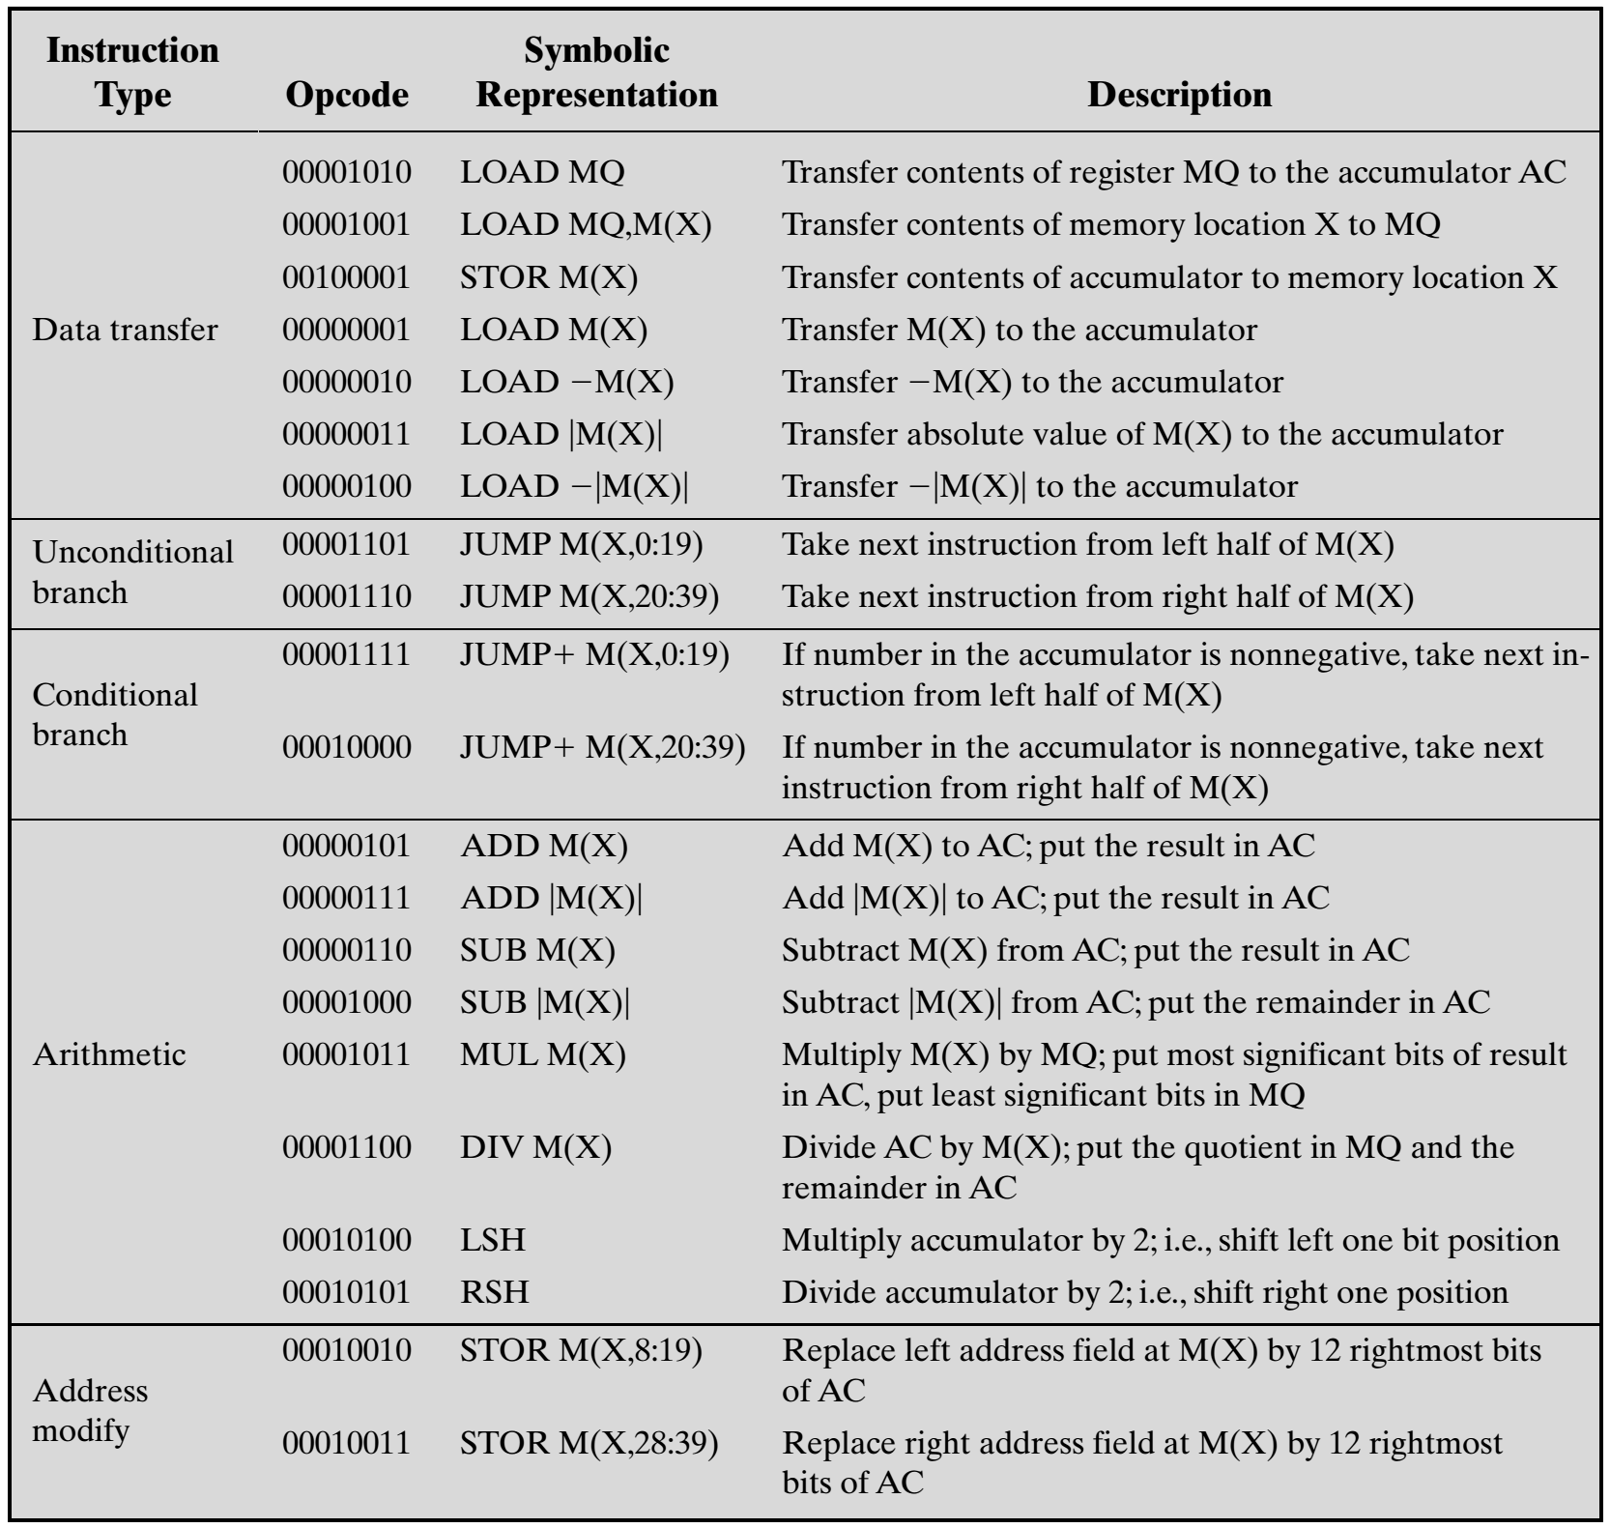
P1

Slide 2
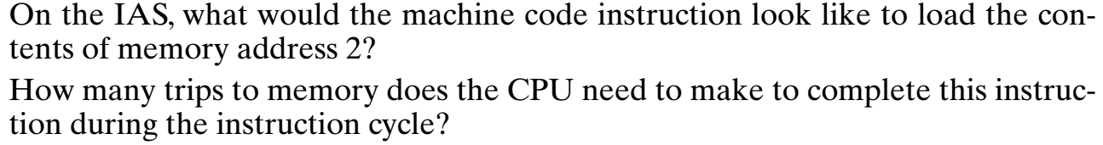
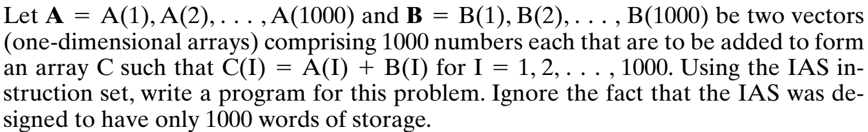
P2
P3

Slide 3
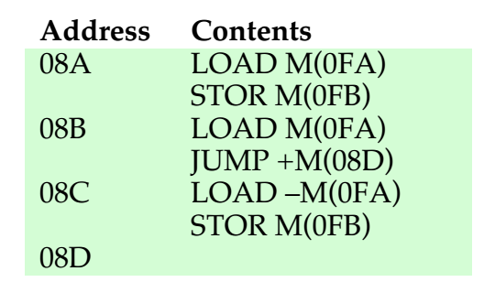
Answer
P1
This program will store the absolute value of content at memory location 0FA into memory location 0FB.
P2
First, the CPU must make access memory to fetch the instruction. The instruction contains the address of the data we want to load. During the execute phase accesses memory to load the data value located at that address for a total of two trips to memory.
OPCODE | OPERAND
00000001 | 000000000010

Slide 4
P4
Write a program for M = (A+B)*C.
P5
Write a program for D = (A-B)/C.
Memory address | Data/Instruction
001 | a
002 | b
003 | c
004 | LOAD M(001) | ADD M(002)
005 | MUL M(003) | JUMP M(5, 20:39)

Slide 5
Example 3
0 15 a
1 5 b
2 c (reserved for c)
begin
If (a >=b)
3 load M(0)
sub M(1)
4 jump+ M(5, 0:19)
jump M(7, 0:19)
true, c=a-b
5 load M(0)
sub M(1)
6 stor M(2)
jump M(8, 20:39)
false c = a+b
7 load M(0)
add M(1)
8 stor M(2)
jump M(8, 20:39)
main () {
int a=15, b=5, c;
if (a >= b)
c = a – b;
else
c = a + b;
}
Notes:
<number>

Slide 6
Example 3 (continued)
0 15 a
1 5 b
2 c
begin
3 load M(0)
sub M(1)
4 jump+ M(5, 20:39)
load M(0)
5 add M(1)
stor M(2)
6 jump M(6, 0:19)
Optimized
Notes:
<number>

Slide 7
0 15 a
1 5 b
2 c
3 1
begin
a > b
4 load M(0)
sub M(1)
5 sub M(3)
jump+ M(6, 20:39)
6 jump M(8, 20:39)
True, c = a- b
load M(0)
7 sub M(1)
stor M(2)
8 jump M(10, 0:19)
False, c = a + b
load M(0)
9 add M(1)
stor M(2)
10 jump M(10, 0:19)
Example3 ( with a > b)
main () {
int a=15, b=5, c;
if (a > b)
c = a – b;
else
c = a + b;
Notes:
<number>

Slide 8
0 1
1 10
2 2 a
3 2 b
4 I
begin
I =1
5 load M(0)
stor M(4)
while (I < 10)
6 load M(4)
sub M(1)
7 jump+ M(11, 0:19)
a = a +b
load M(2)
8 add M(3)
stor M(2)
I=I+1
9 load M(4)
add M(0)
10 stor M(4)
jump M(6, 0:19)
11 jump M(11, 0:19)
Example 6
main () {
int a=2, b=2, I;
I = 1;
while (I < 10) {
a = a +b;
I = I +1;
}
}
Notes:
<number>

Slide 9
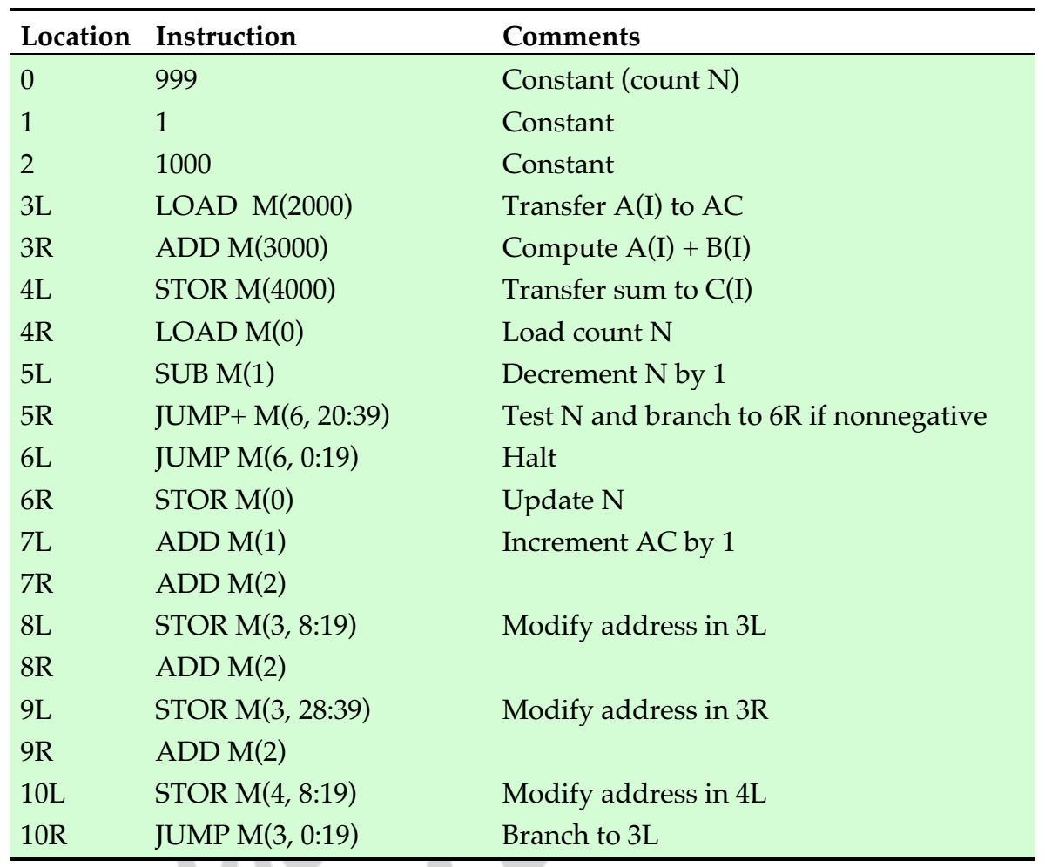
Answer
P3
The vectors A, B, and C are each stored in 1,000 continuous locations in memory, beginning at locations 1001, 2001, and 3001, respectively. The program begins with the left half of location 3. A counting variable N is set to 999 and decremented after each step until it reaches -1. Thus, the vectors are processed from high location to low location.

